Slide 1
Campaign Overview
MARYLAND GENERAL
ASSEMBLY SESSION 2021

Slide 2
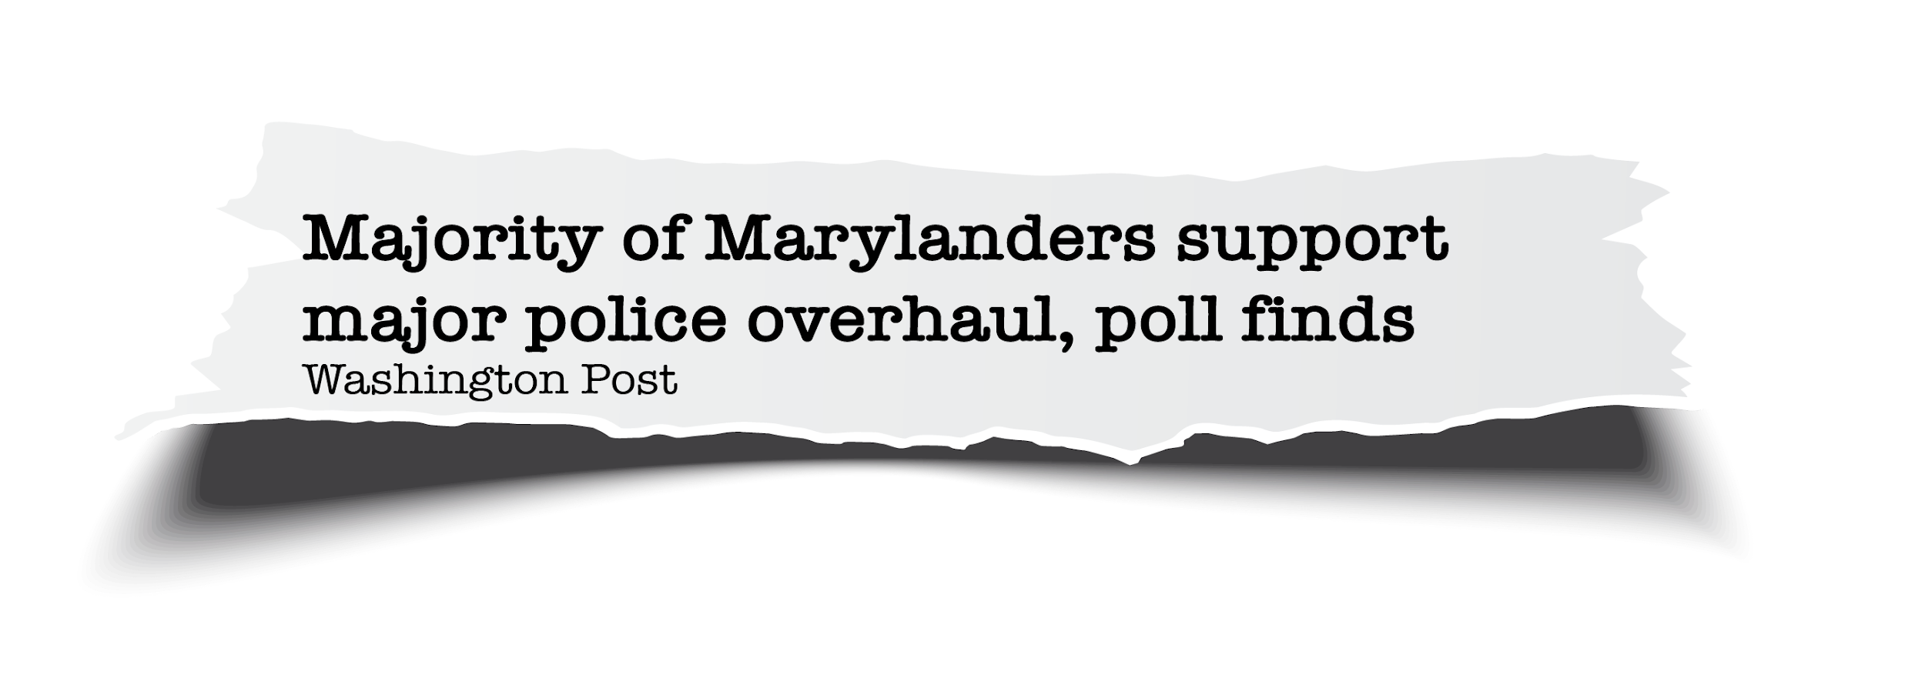
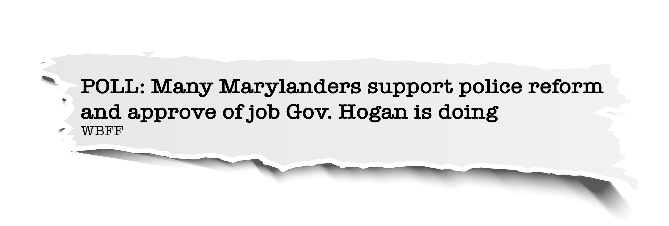
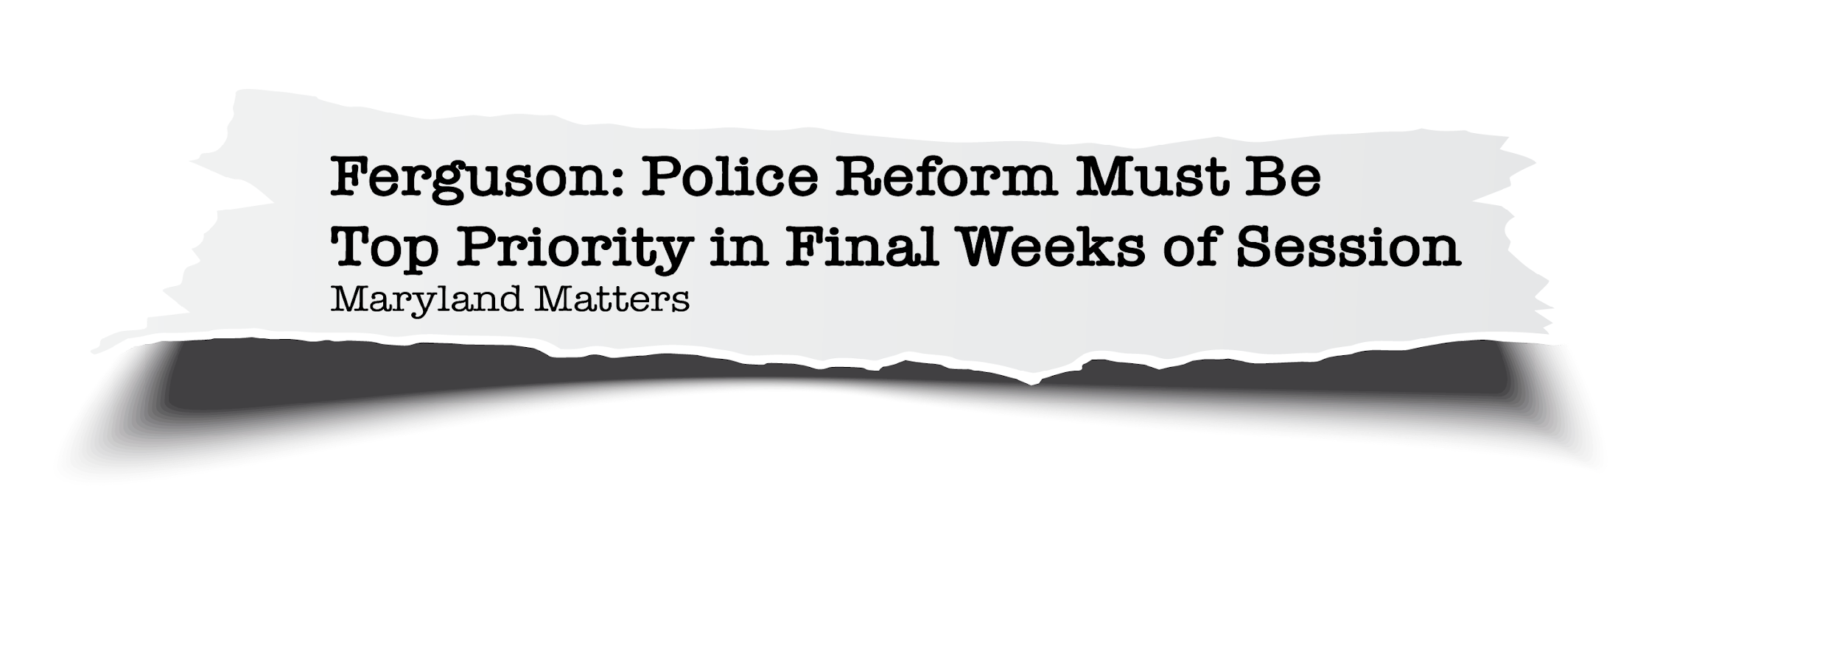
Where We Started

Slide 3
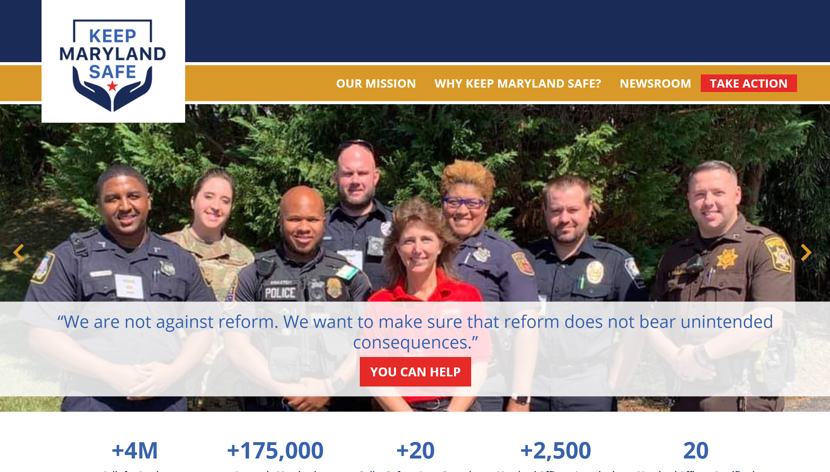
The Work Begins
“
Working together to build trust – and enact meaningful reforms – that will help law enforcement officers keep Maryland safe by supporting the Commission to Restore Trust in Policing recommendations to hold police managers accountable for the hiring, training and supervision of law enforcement officers.”
KEEPMARYLANDSAFE.COM | January 2021

Slide 4
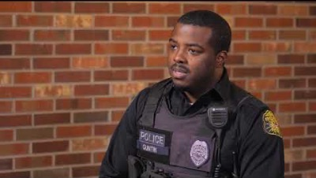
Campaign Highlights
Keep Maryland Safe| January 2021
“
It takes a very special person to run towards the gun fight and not run away. If they take away due process, you won’t have those very special people.”
SR. CPL. SHANNON BALDWIN
PRINCE GEORGE’S COUNTY
POLICE DEPARTMENT

Slide 5
Campaign Highlights
+62.6K
Emails to Legislators
GRASSROOTS MESSAGING
+5,600
New Senders
189
Legislators Engaged

Slide 6
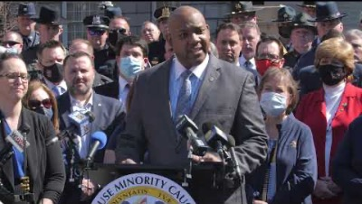
Campaign Highlights
100+
In Attendance
“
PRESS CONFERENCE | March 10, 2021
We support Maryland’s law enforcement community, and the selfless and far too often unheralded work they do to keep our families and our communities safe. The debate over police reform is an important debate…but it’s been largely devoid of facts…”
DEL. KATHY SZELIGA
MD-7

Slide 7
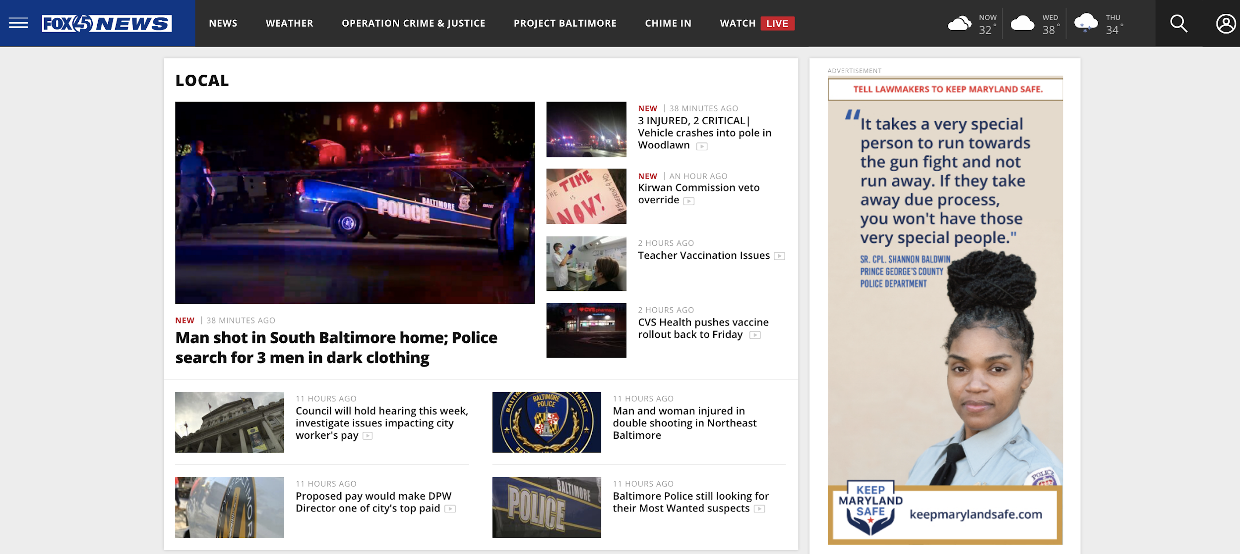
Campaign Highlights
PSAs

Slide 8
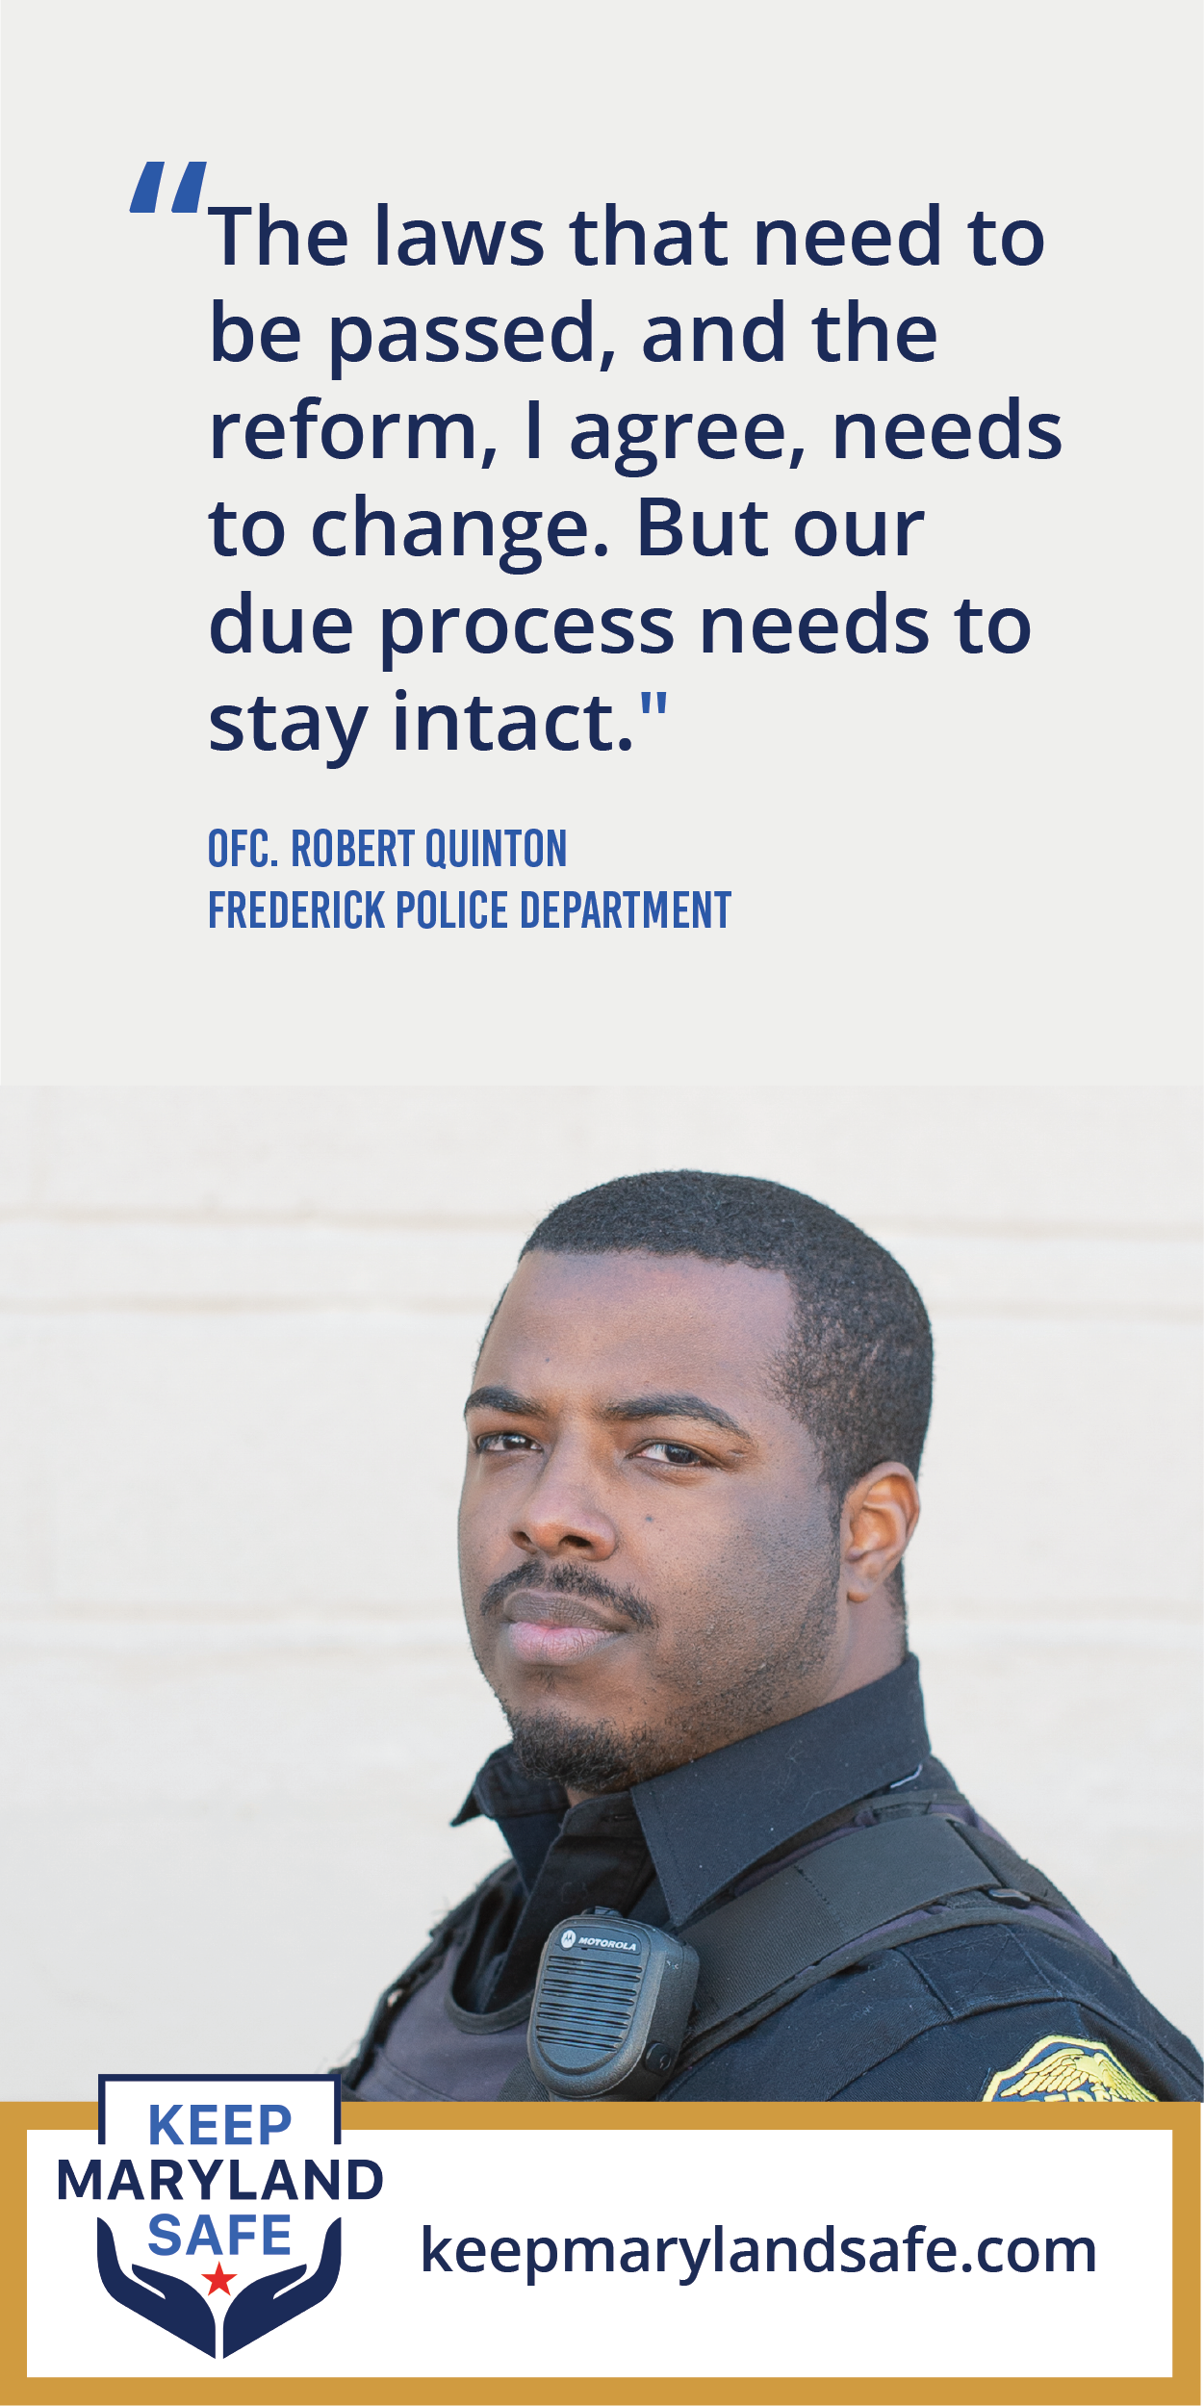
Campaign Highlights
PSAs

Slide 9
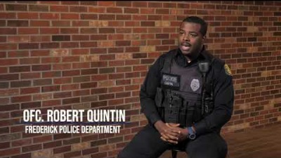
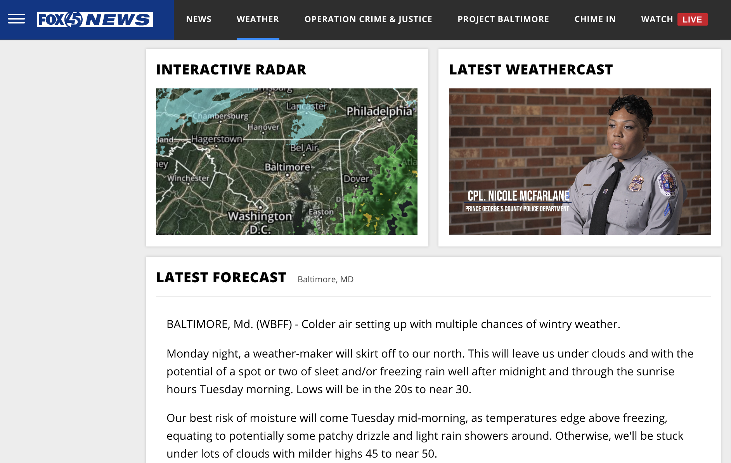
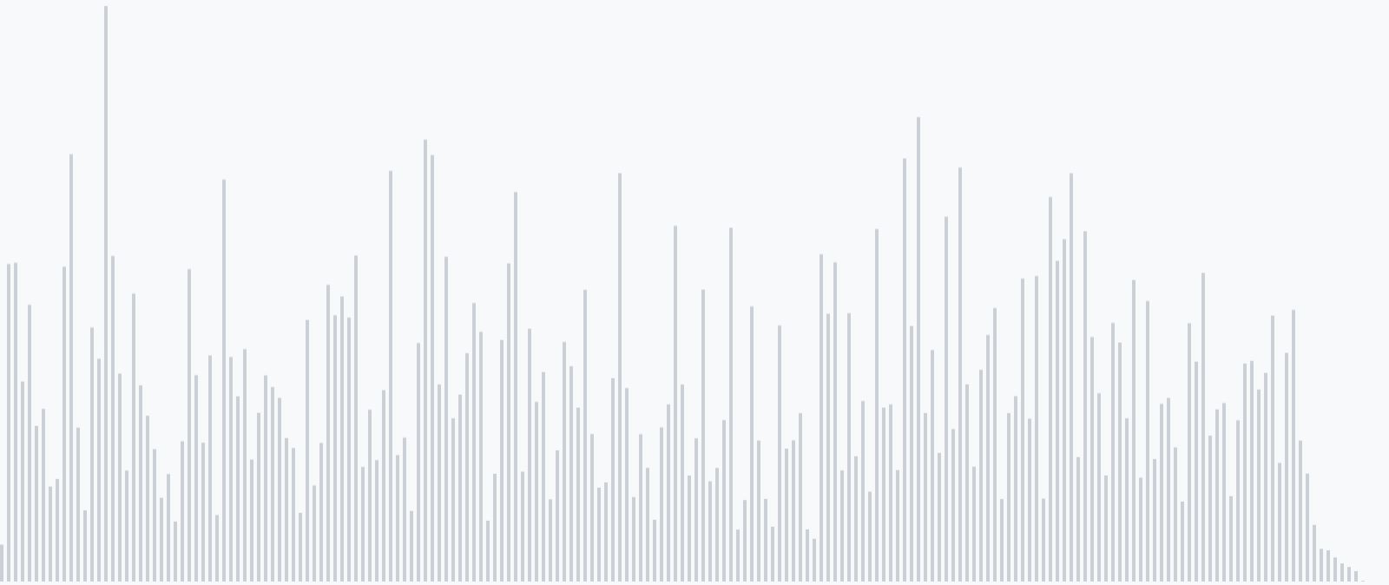
Campaign Highlights
RADIO

Slide 10
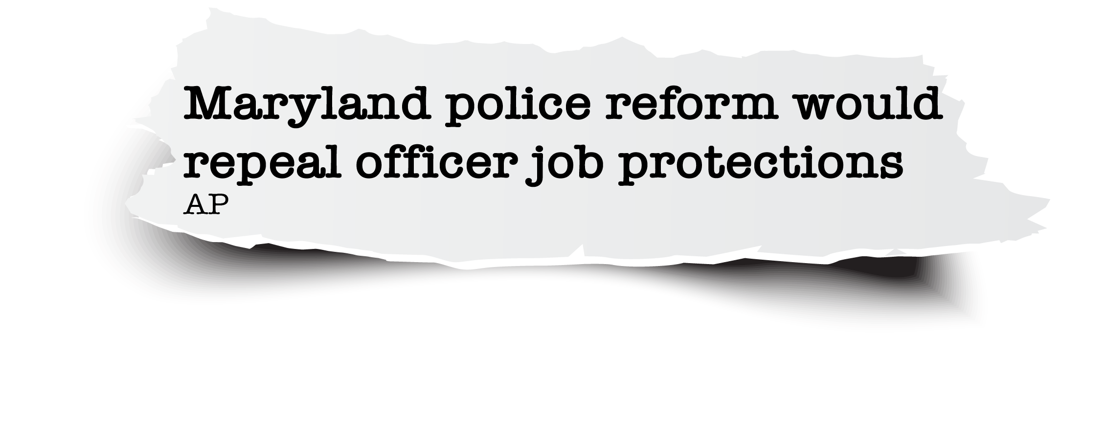
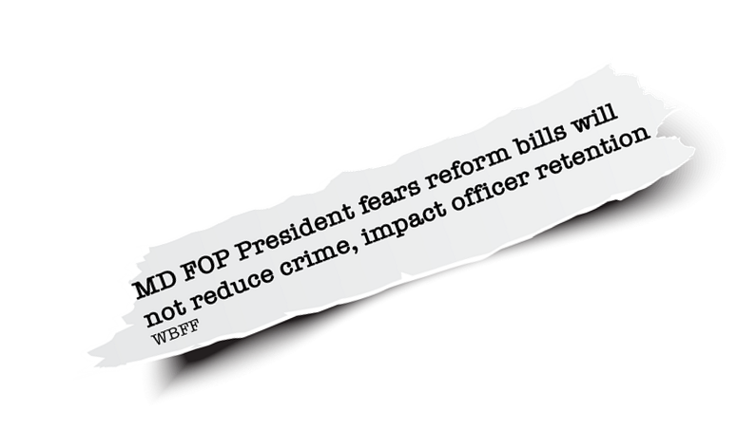
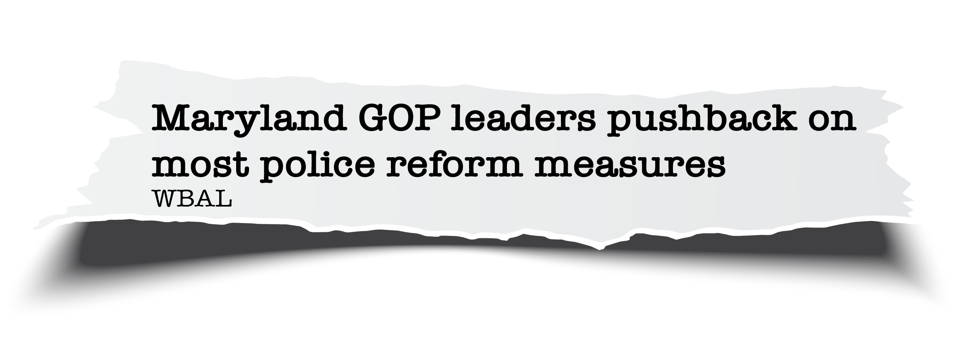
Working for Law Enforcement

Slide 11
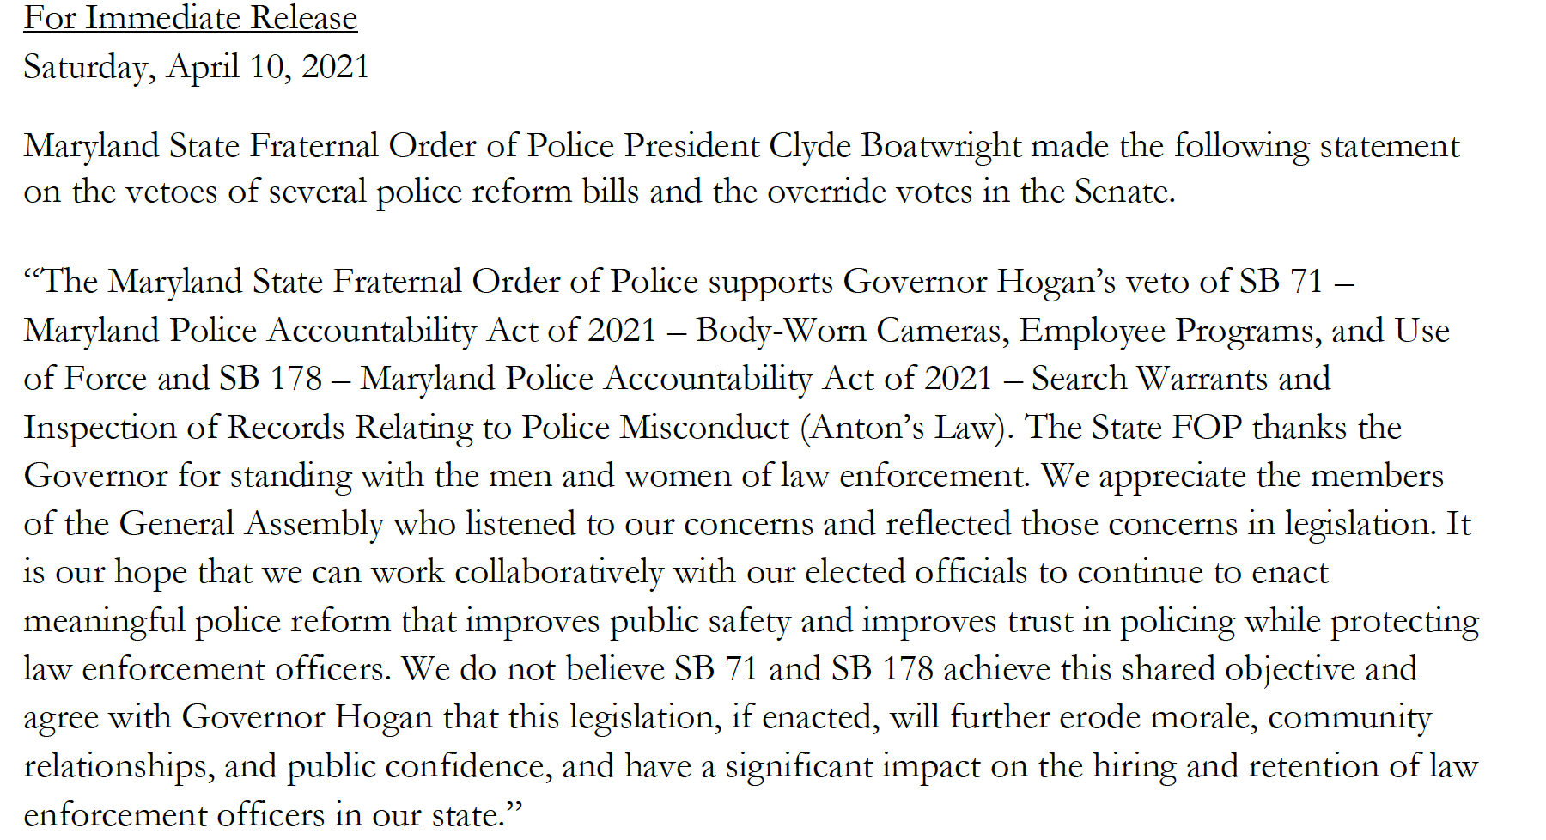
Still Standing

Slide 12
The Work Continues
Maryland Police Accountability Legislation Passed, Maryland General Assembly 2021
HB 670: Maryland Police Accountability Act-Police Discipline and Law Enforcement Programs and Procedures (Due Process/LEOBR replacement)
SB 71: Body Worn Cameras (BWC), Employee Programs, and Use of Force
SB 178: Search Warrants and Inspection of Records Relating to Police Misconduct (Anton’s Law)
SB 786: Baltimore City - Control of the Police Department of Baltimore City
SB 600: Surplus Military Equipment and Investigation of Deaths Caused by Police Officers

Slide 13
Proposed Reform
vs. MPAA of 2021
The LEOBR section of the Maryland Police Accountability Act of 2021 shall be construed to apply only prospectively and may not be applied or interpreted to have any effect on, or application to, any bona fide collective bargaining agreement entered on or before June 30, 2022, for the duration of the contract term, excluding any extension, options to extend, or renewals of the term or the original contract, or for a disciplinary matter against an officer based on alleged misconduct occurring before July 1, 2022.

Slide 14
What’s Next?
Maryland General Assembly 2022
Identify what do we need to do better
Gather data
Tell us your stories in the community
Develop proactive legislative strategy

